Slide 1
3D Face Morphing Using Landmark-Based Deformation
Onur koçak
AbdelRahman Mohamed
comp410

Slide 2
Project Motivation
Goal: morph a generic 3D face mesh to resemble a person in a 2D photo
Why morph 2D faces into 3D?
Custom avatars / animation / medical simulation

Slide 3
System Pipeline overview
Input Image → Landmark Detection → Landmark Mapping → 3D Mesh Morphing → Error Visualization → Export

Slide 4
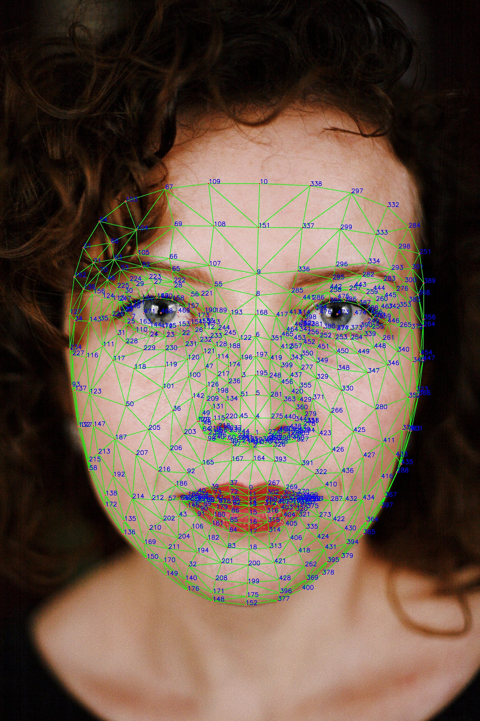
Landmark Detection (MediaPipe)
Input face image
Use MediaPipe Face Mesh
to extract 468 facial landmarks

Slide 5
Landmark-to-Vertex Mapping
Manually identify 6 corresponding points between MediaPipe landmarks and mesh vertices (e.g., nose tip, eyes, mouth).
Compute a similarity transform (scale, rotation, translation) to align the landmarks to the mesh using these reference points.
Transform all landmarks to the mesh space.
For each transformed landmark, find the closest vertex on the mesh using Euclidean distance.
Result: a landmark-to-vertex map is saved as a json file.

Slide 6
Morphing Algorithm
Compare that mesh vertex's position to the same landmark's position from the target image.
Compute a displacement vector (a 3D delta) between the original and target positions.
Displacements are applied to the corresponding mesh vertices, moving them toward the target landmark.

Slide 7
Post morph smoothing
Direct application of deltas can create unnatural surface irregularities.
We apply Laplacian smoothing to evenly distribute the deformation and preserve mesh quality.

Slide 8
Error Metrics
Compare deformed mesh vertices to reference landmarks
Per-landmark Euclidean distance
Visualise landmark error reported per image

Slide 9
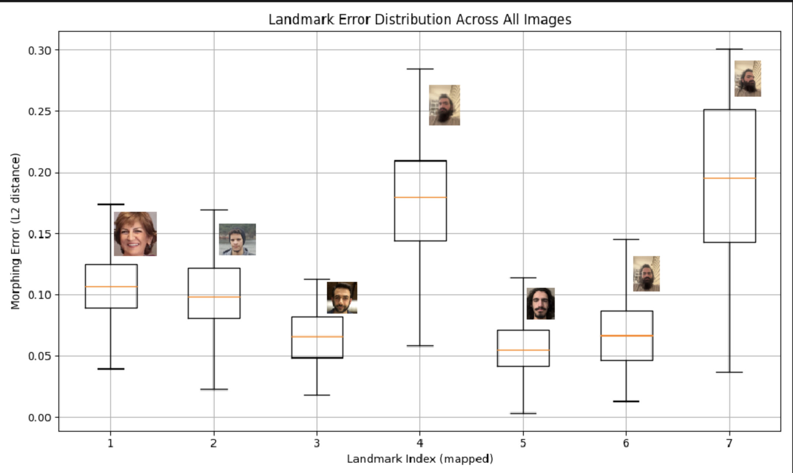
Average landmark error boxplot

Slide 10
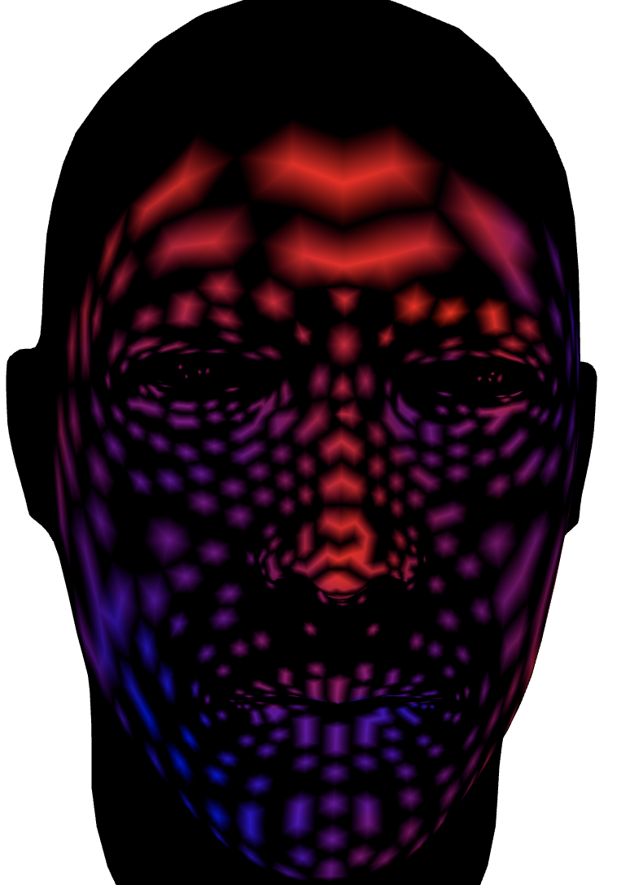
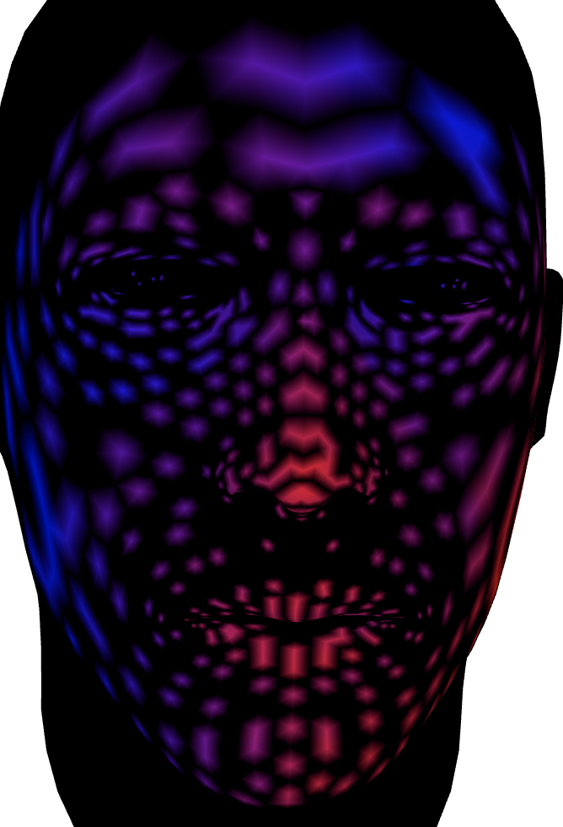
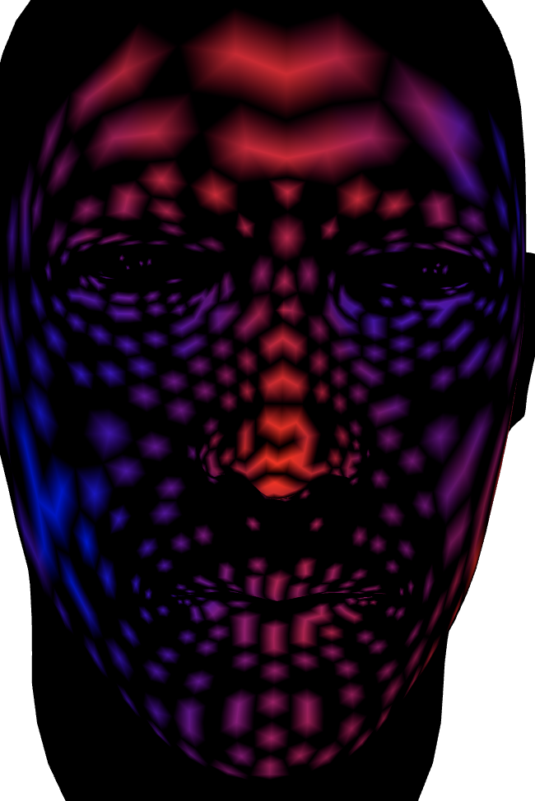
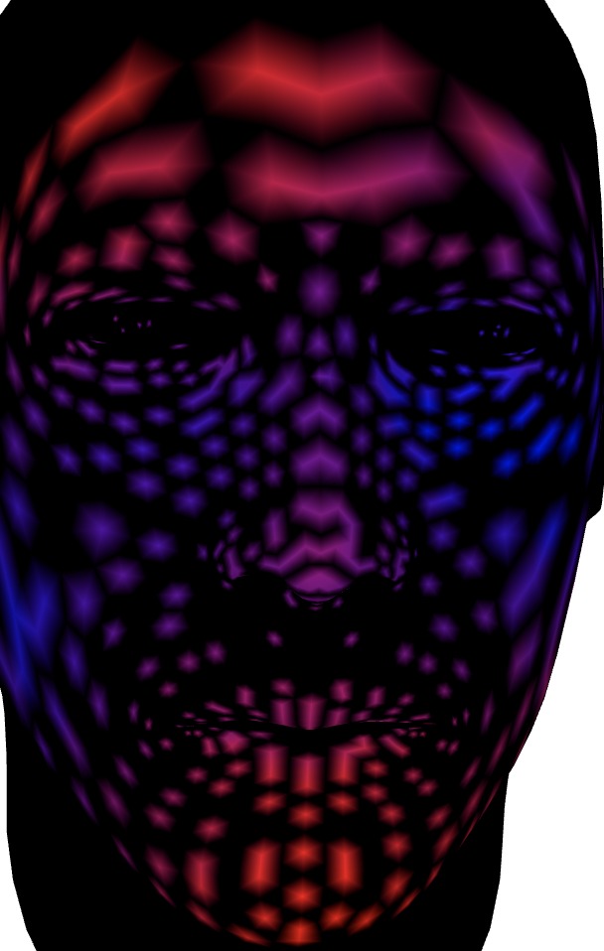
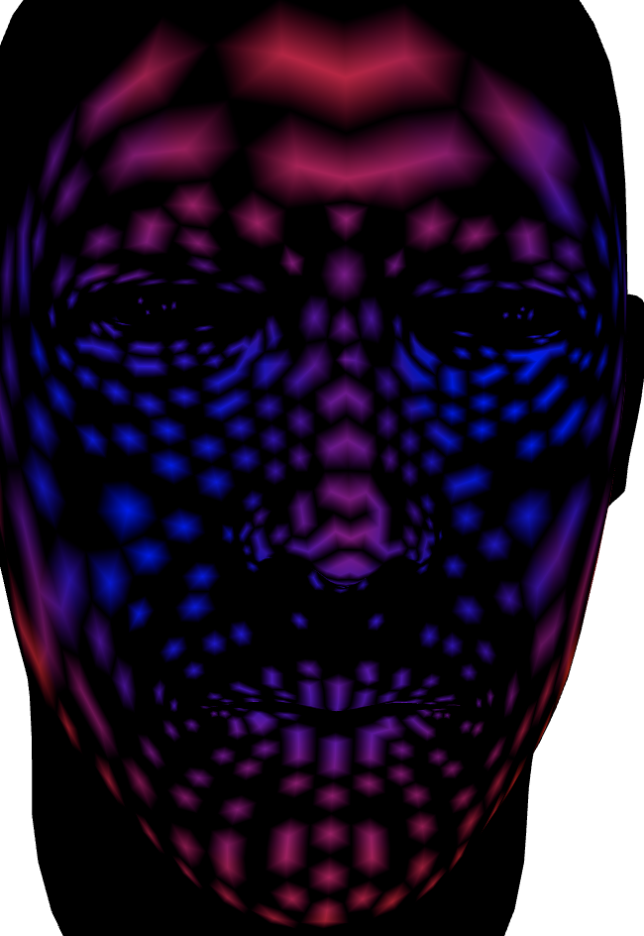
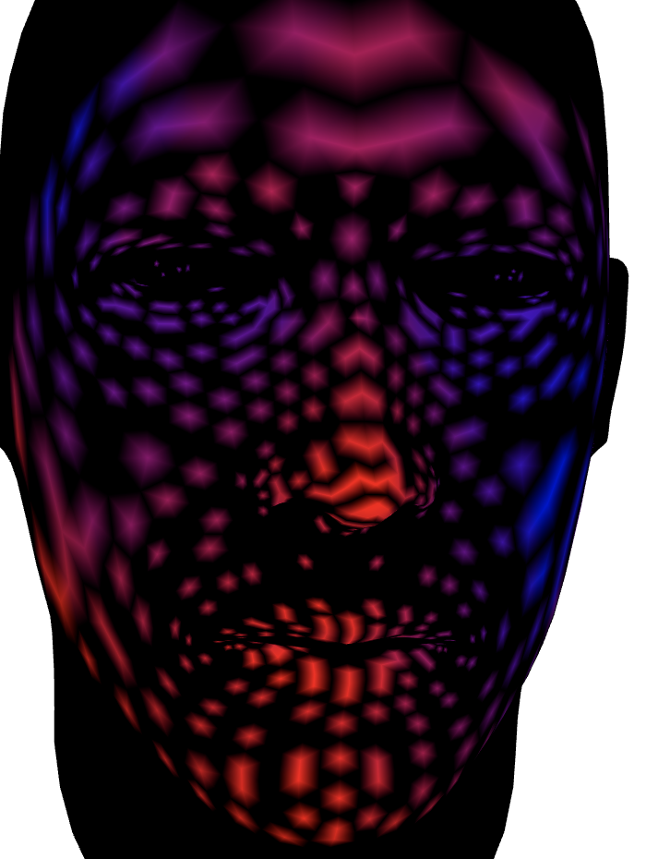
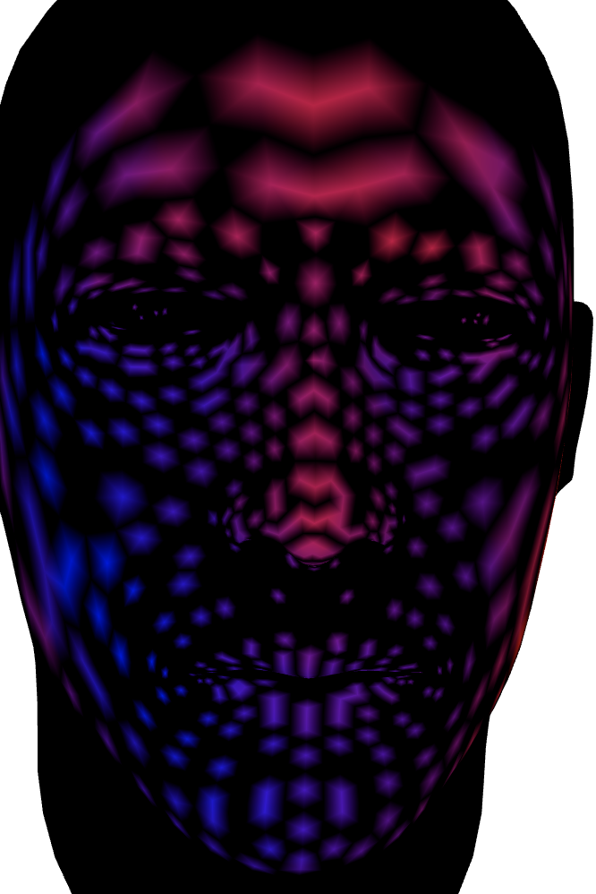







Landmark error heatmaps

Slide 11
Example outputs
Strength: 0.2
smoothing_lambda: 0.06
smoothing_iterations:500

Slide 12
Note on values and paramiters
Strength: Controls how strongly the mesh deforms toward the landmark-based deltas.
smoothing_lambda: Controls how strongly smoothing pulls vertices toward their neighbors.
smoothing_iterations: Number of smoothing passes over the mesh.
We don’t think the ones used is the optimal values and that the results can be improved by using such values. However we weren’t able to test extensively

Slide 13
Conclusion
Semi-automatic vertex-lendmark mapping
Working morphing using landmark-based deformation
Future work: automatic texture mapping, accuracy improvement

